Slide 1

Automation Of Water Irrigation System Using Wireless Sensor

Slide 2
Motivation
Freshwater scarcity has been one of the world's most pressing issues. Thus, one of the most important factors addressed by the authors is conserving water and minimizing wastage while irrigating crops.
Some of the essential nutrients required by plants are present in the upper soil layers. These nutrients drain away as a result of water-logging and dehydration, which erodes the soil. Providing the right amount of water for the correct duration is crucial for improving crop yields.

Slide 3
Objective
The manual operation of the water pump causes complications for farmers, leading to either over-irrigation or under-irrigation of the plants. Farmers can't quite tell how much moisture is in the soil or even what the weather is like. So, the objective is to optimize the irrigation duration, considering parameters such as soil moisture, meteorological conditions and crop health.

Slide 4
Devices used in the experiment
Raspberry Pi Model B
Capacitive soil moisture sensor
Camera module V2
Water pump and Relay
Raspberry Pi Touch Display

Slide 5
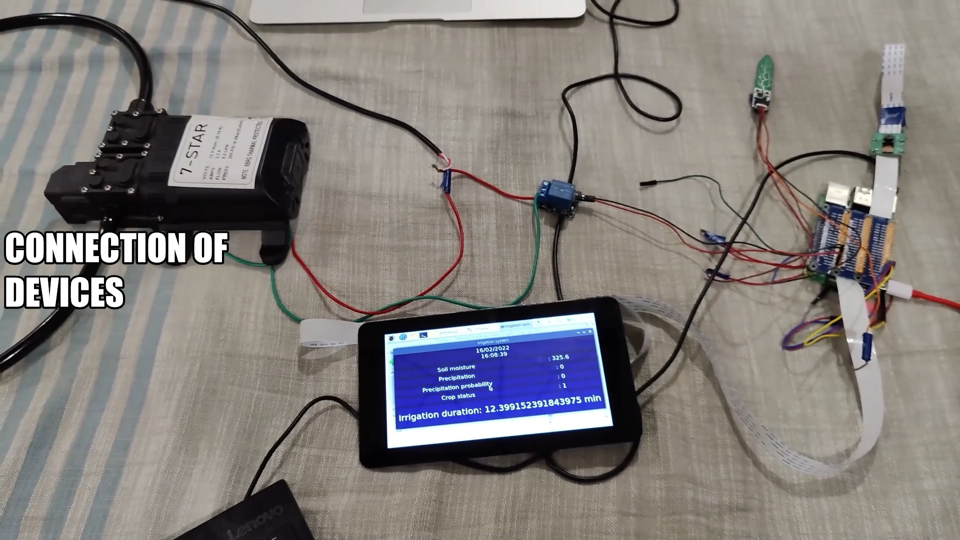
Experimental setup of devices

Slide 6
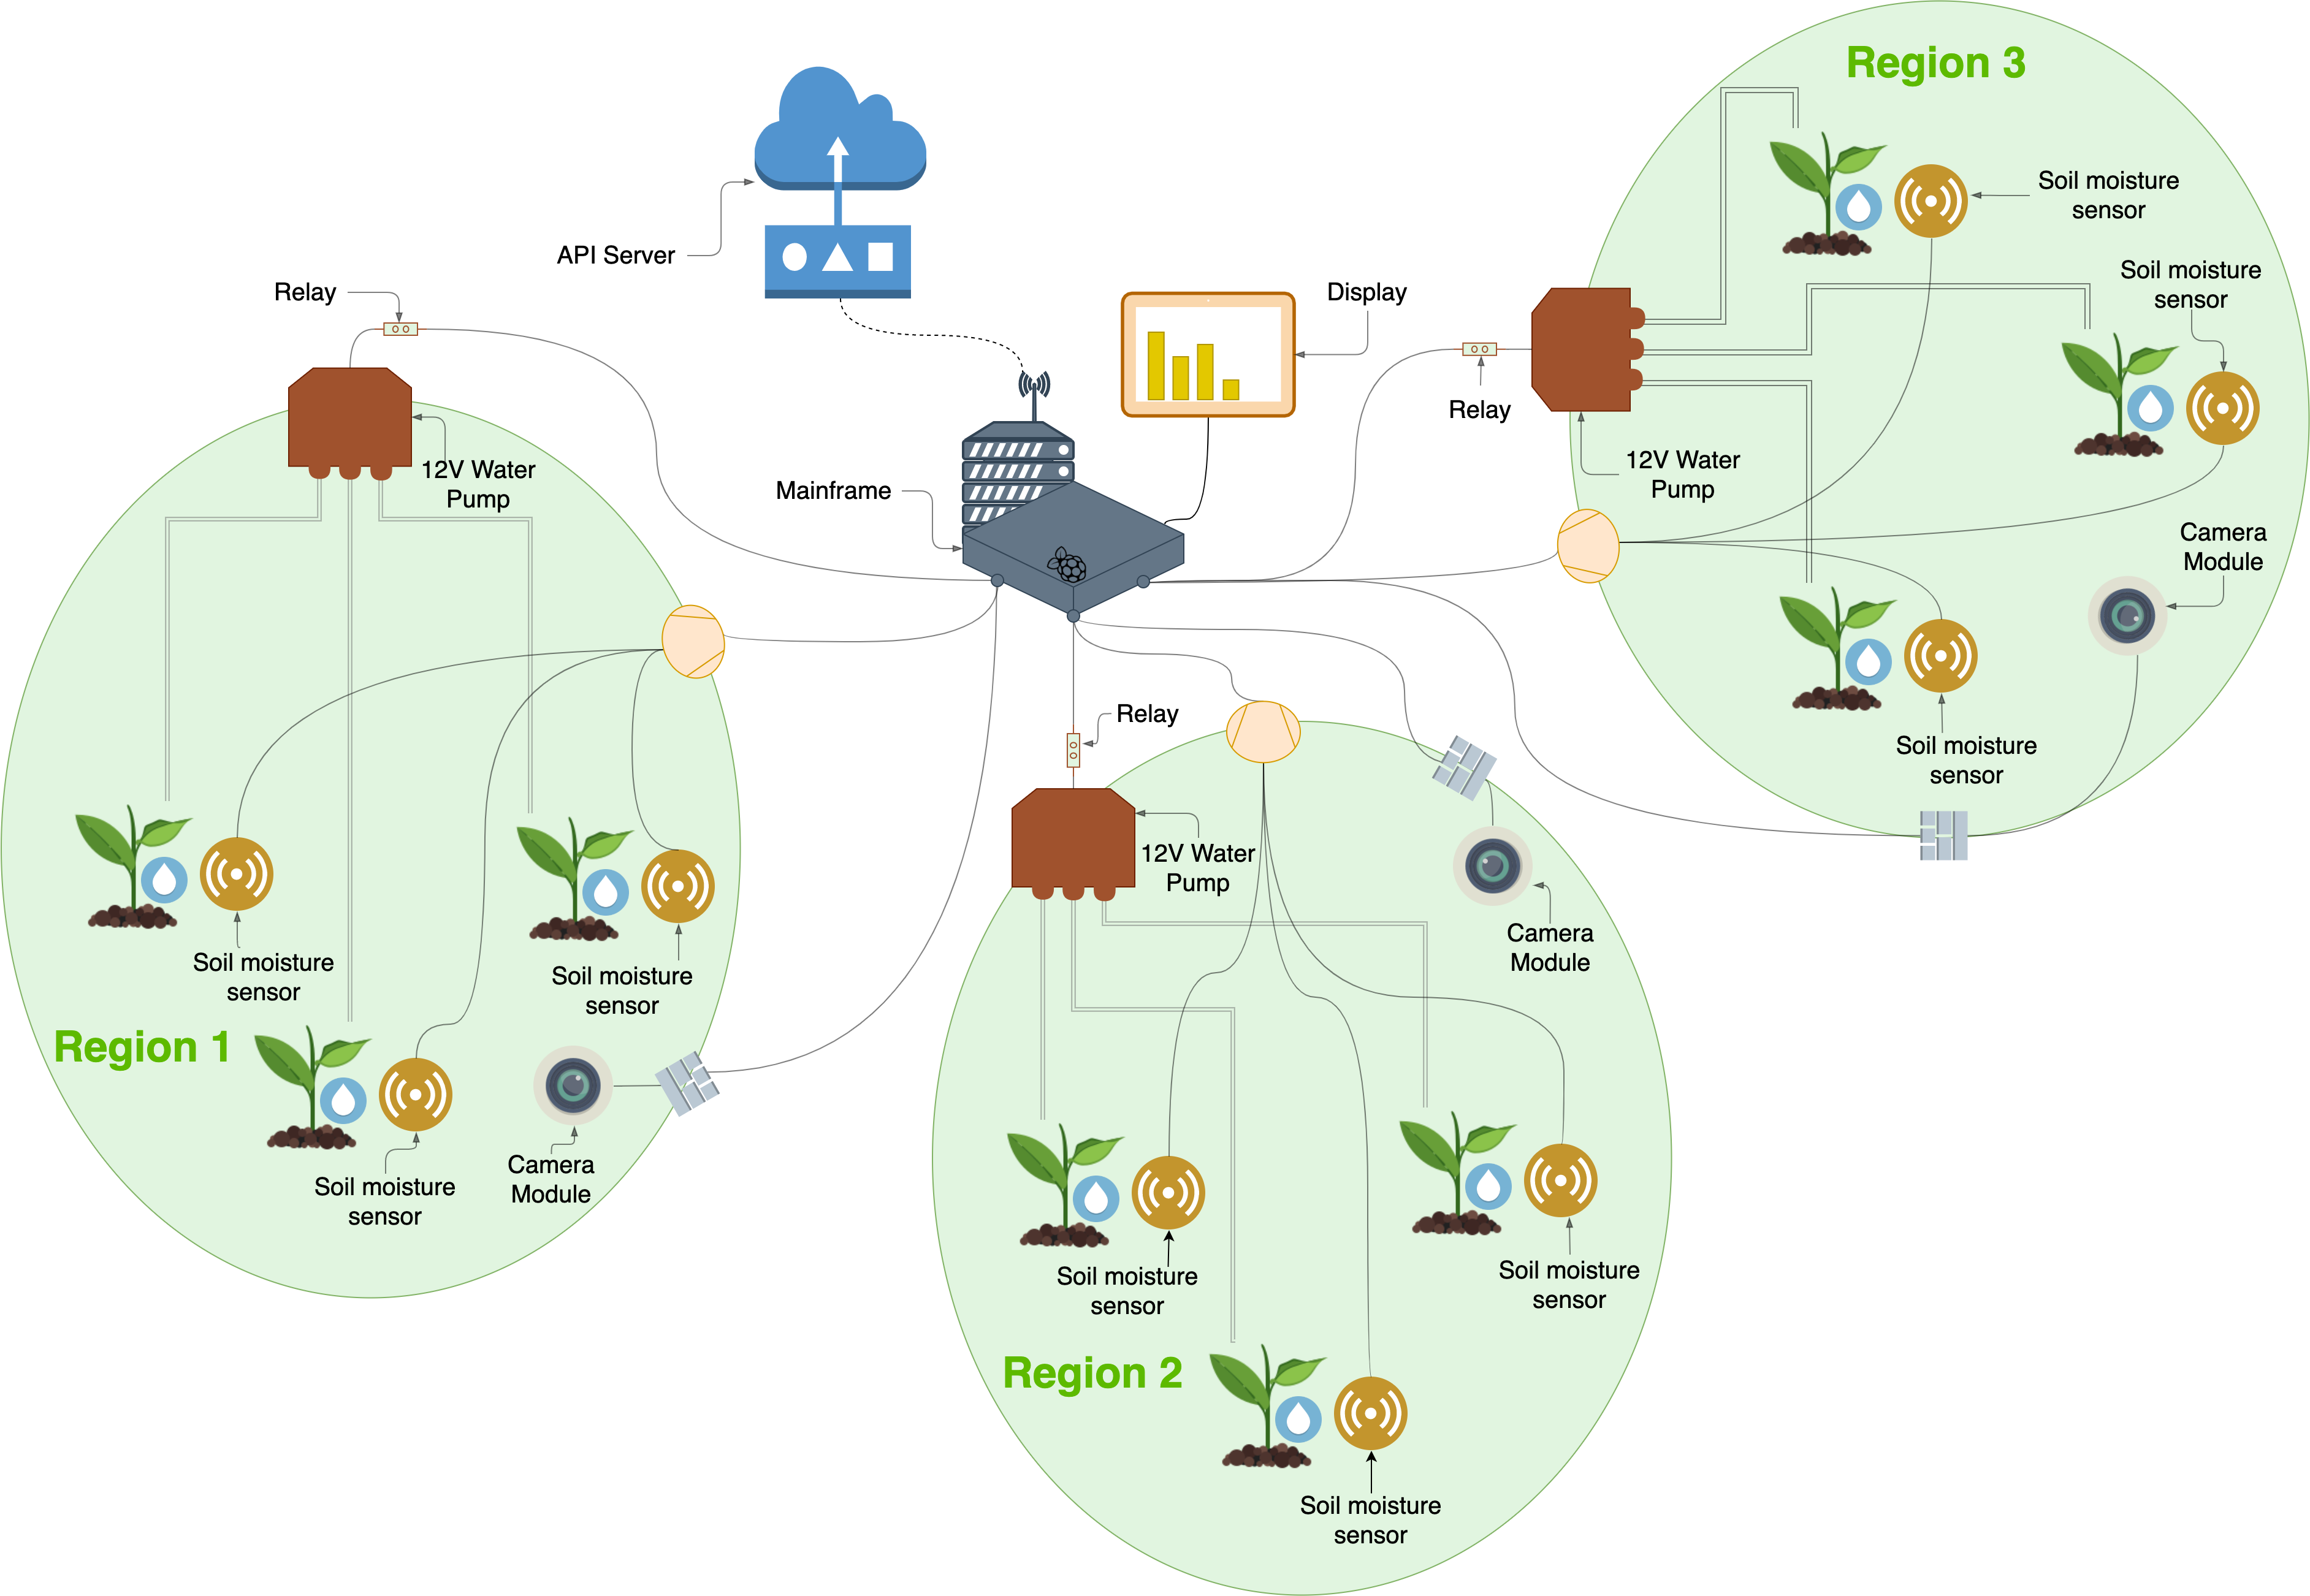
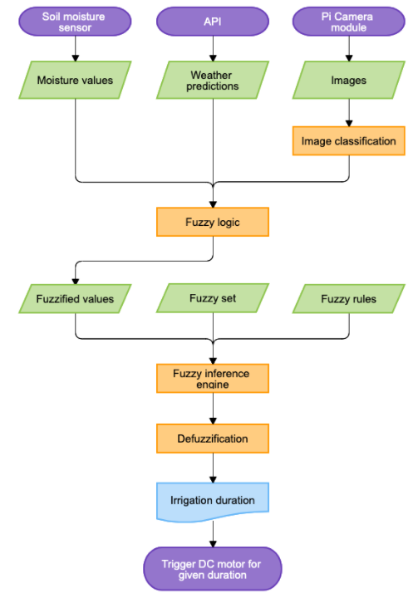
Experimental setup of devices

Slide 7

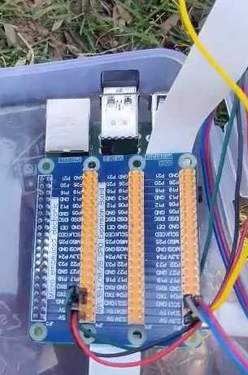
Raspberry Pi 4 Model B
Controls the sensors and perform computation
Perform image classification
Calculate irrigation duration using fuzzy logic, activate the motor for that duration and display measurements on the Display

Slide 8
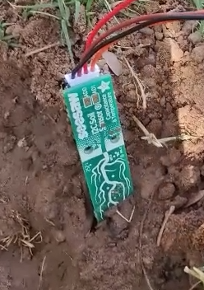
Soil moisture sensor
The sensor used is capacitive which gives precision and doesn’t corrode like resistive soil moisture sensor.
It gives the accurate averaged reading of soil moisture in the range of 200(Dry) to 1500(Wet).
The sensors are connected to Raspberry Pi. It uses I2C protocol to transmit measured data so SDA and SCl pins are used.

Slide 9
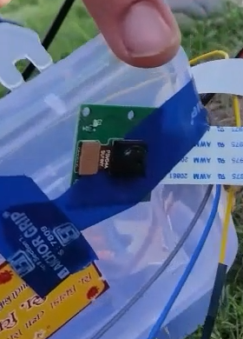
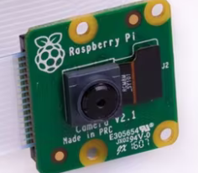
Camera module V2
Captures the image of crop and determine crop status to droop or healthy.
Camera is connected using the 2-lane MIPI CSI camera port of the Raspberry Pi.

Slide 10
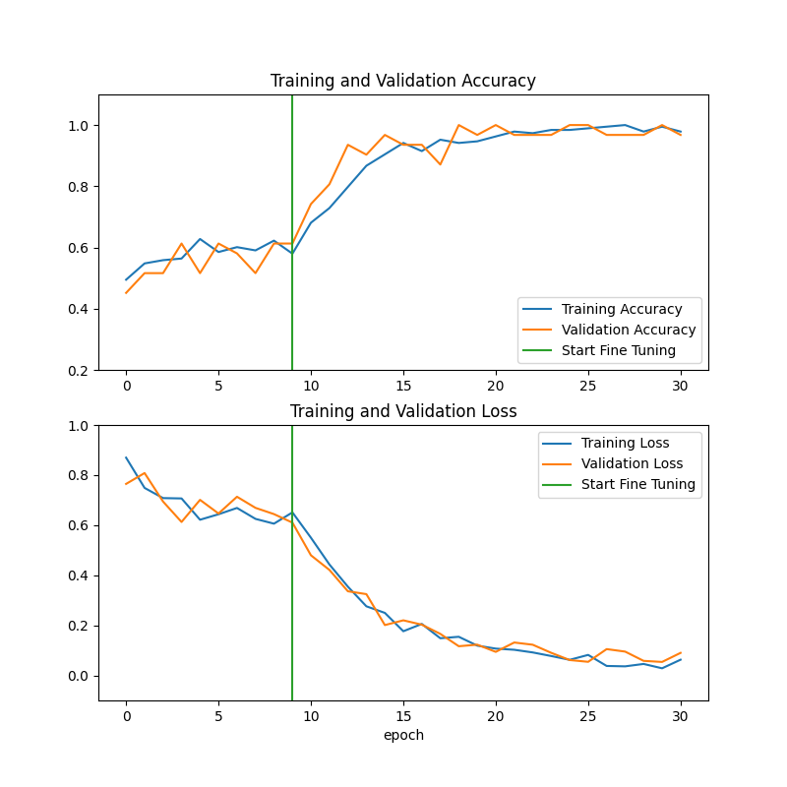
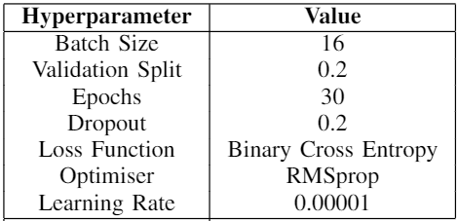
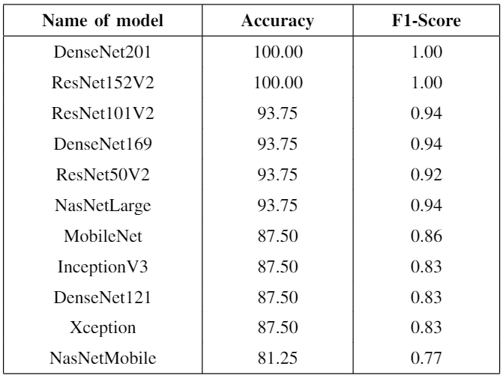
Transfer learning accuracy and loss graph, hyperparameters and comparison of model
Densenet201

Slide 11
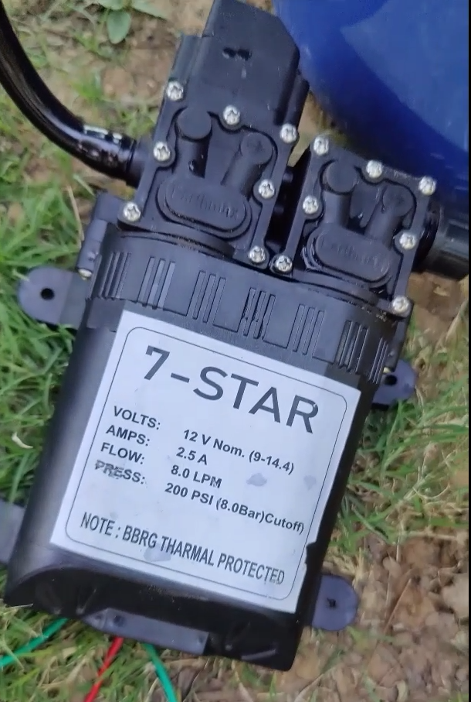
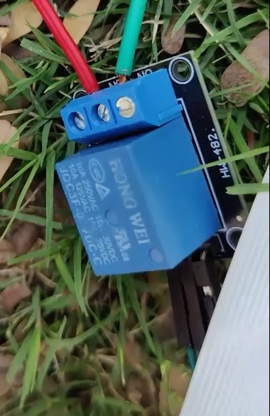
Water pump and Relay
Water pump to water plants for calculated duration.
Power to water pump is supplied using adapter and is controlled through relay by raspberry pi. It turns ON/OF according to the state of the controlling pin on raspberry pi.
Relay

Slide 12
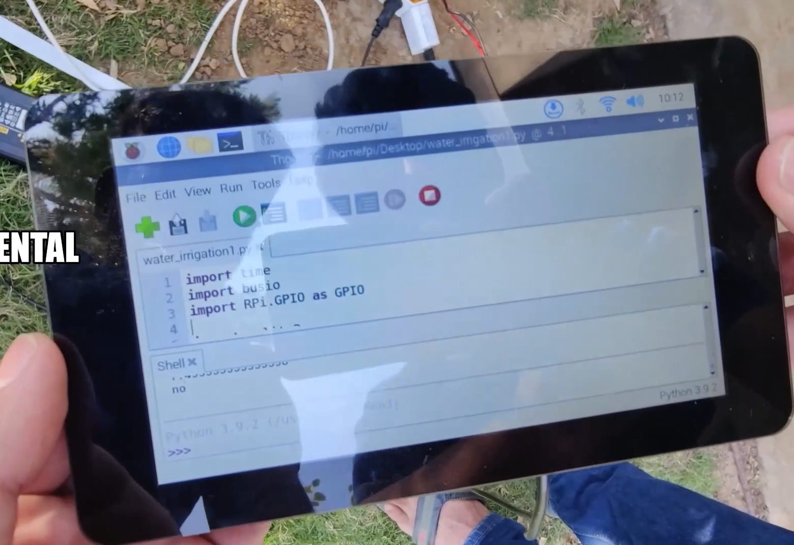
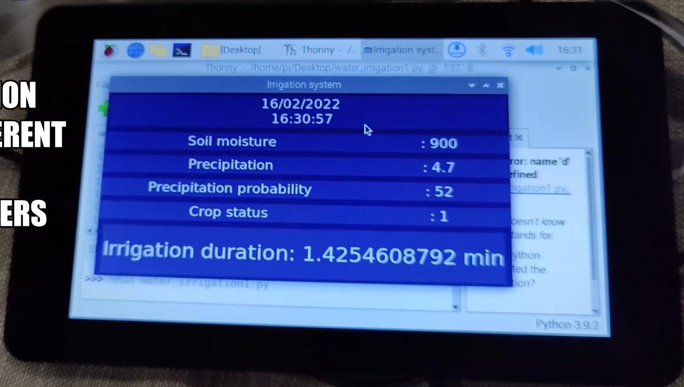
Raspberry Pi Touch Display
Display the measurements and irrigation duration
Touch display is connected using MIPI DSI display port to Raspberry Pi and powered using adapter.

Slide 13
API
Current weather conditions are fetched using API.
Precipitation in past 24 hours and precipitation probability for next 24 hours are extracted from the result of API response and passed to fuzzy logic.

Slide 14
Complete setup
Transfer learning is applied on the image captured by camera and classified into droop or healthy plant. Densenet201 model was used for classification.
The readings from all the sensors, outcome of model and API is fed to fuzzy logic interface which calculates irrigation duration and activates motor for the calculated period of time.
After the completion of irrigation, the system goes in sleep until specified period of time (It is set to one day in the experiment).

Slide 15
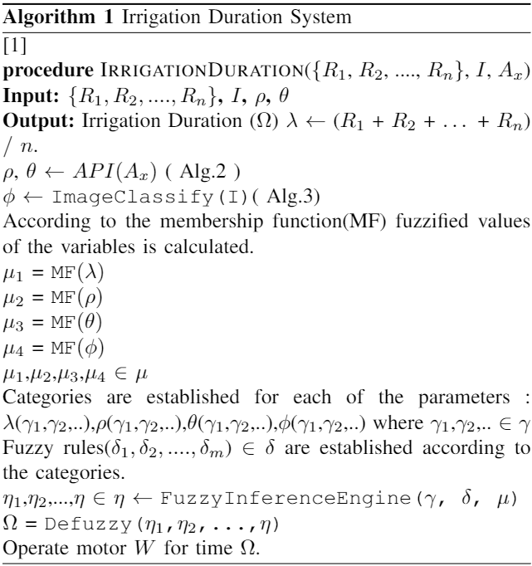
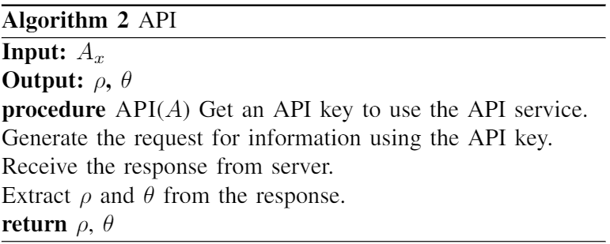
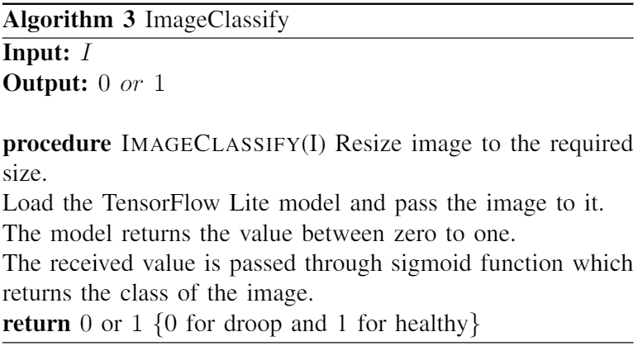
Algorithms

Slide 16
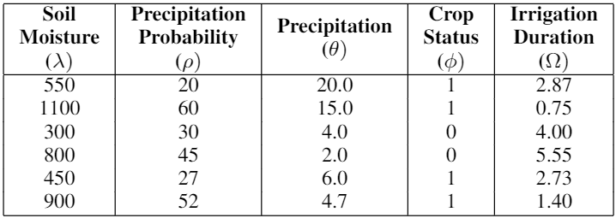
Fuzzy logic output for different conditions

Slide 17
Comparison
The authors in [1] used resistive soil moisture sensor which corrode over time which results in measurement errors, so system have to be re-calibrated more oftenly and sensors have to be replaced. To overcome this problems, capacitive soil moisture sensor is used. Moreover, the authors have taken a single image whereas we have captured the images of the crops at the interval of every 24 hours which gives the latest crop status and accordingly the irrigation duration would be computed. Furthermore, the authors in [1] haven’t used any specific logic in order to combine all the parameters generated unlikely we have used fuzzy logic to combine all the parameters so that appropriate time duration for watering the crops can be computed.
[1] R. Geethamani, S. Jaganathan, M. S, N. k. S, P. S, and J. R, “Implementation of smart agricultural monitoring system using raspberry pi,” in 2021 Innovations in Power and Advanced Computing Technologies (i-PACT), pp. 1–6, 2021.

Slide 18
Thank You

